Slide 1
Distance Vector Routing
Prepared by
Divya K S
Adi Shankara Institute of Engineering & Technology
Kalady

Slide 2
Dynamic routing algorithm
Two dynamic algorithms are the most popular
Distance vector routing and
Link state routing

Slide 3
Distance Vector Routing (DVR)
Algorithms operate by having each router maintain a table (i.e, a vector) giving the best known distance to each destination and which line to use to get there.
These tables are updated by exchanging information with the neighbors
Other names:
distributed Bellman-Ford routing algorithm
Ford-Fulkerson algorithm
original ARPANET routing algorithm used in Internet under the name RIP (Routing Information Protocol)

Slide 4
Routing Algorithms - DVR
In DVR, each router maintains a routing table containing one entry for each router in the subnet.
This entry contains two parts:
the preferred outgoing line to use for that destination
an estimate of the time or distance to that destination
The metric used might be
number of hops,
time delay in milliseconds,
total number of packets queued along the path, or
something similar

Slide 5
Distance vector Routing
The starting assumption for distance vector routing is that each node knows the cost of the link to each of its directly connected neighbours.
Distance to other nodes are assigned to an infinite cost

Slide 6
Steps
Step-01:
Each router prepares its routing table. By their local knowledge. each router knows about-
All the routers present in the network
Distance to its neighboring routers
Step-02:
Each router exchanges its distance vector with its neighboring routers.
Each router prepares a new routing table using the distance vectors it has obtained from its neighbors.
This step is repeated for (n-2) times if there are n routers in the network.
After this, routing tables converge / become stable.

Slide 7
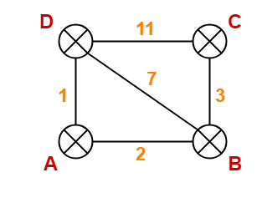
Distance Vector Routing Example-
Consider-
There is a network consisting of 4 routers.
The weights are mentioned on the edges.
Weights could be distances or costs or delays.

Slide 8
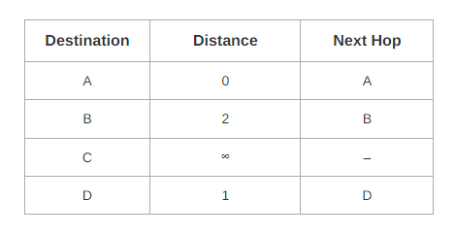
Step-01: Each router prepares its routing table using its local knowledge.
At Router A-

Slide 9
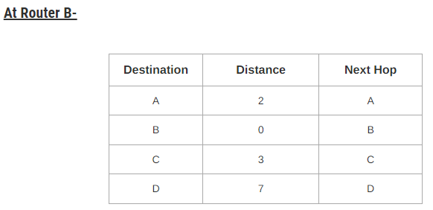
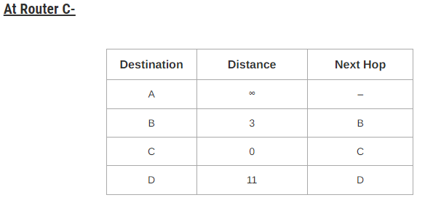

Slide 10
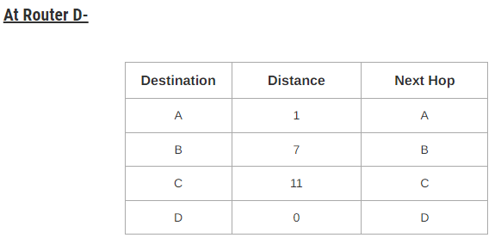

Slide 11
Step-02:
Each router exchanges its distance vector obtained in Step-01 with its neighbors.
After exchanging the distance vectors, each router prepares a new routing table by updating the distance based on the following equation
Let dx(y) be the cost of the least-cost path from node x to node y.
The least costs are related by Bellman-Ford equation,
dx(y) = minv{c(x,v) + dv(y)}
where,
dx(y)= The least distance from x to y c(x,v)= Node x's cost from each of its neighbour v dv(y)= Distance from neighbor to node y minv= selecting shortest distance.

Slide 12
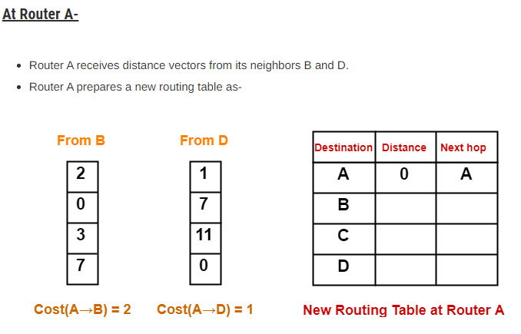

Slide 13
Cost of reaching destination B from router A = min { 2+0 , 1+7 } = 2 via B.
Cost of reaching destination C from router A = min { 2+3 , 1+11 } = 5 via B.
Cost of reaching destination D from router A = min { 2+7 , 1+0 } = 1 via D.

Slide 14
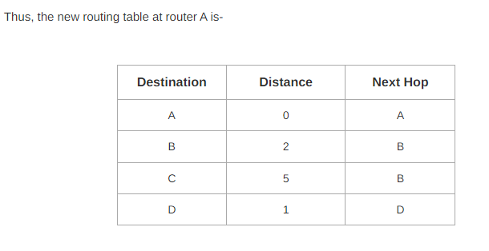

Slide 15
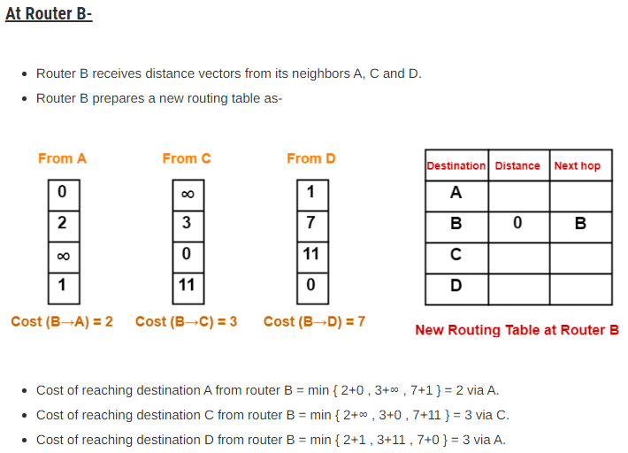

Slide 16
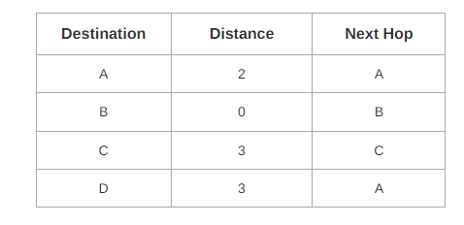
New routing table at router B is-

Slide 17
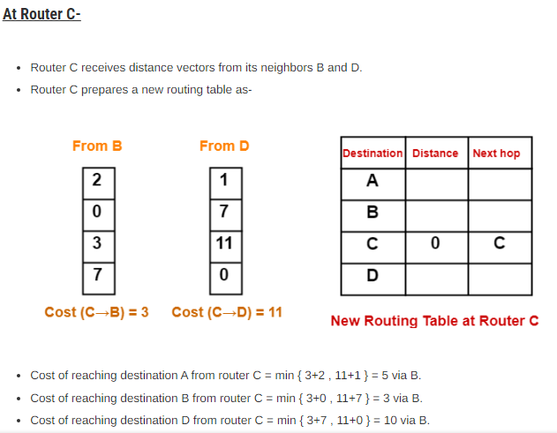

Slide 18
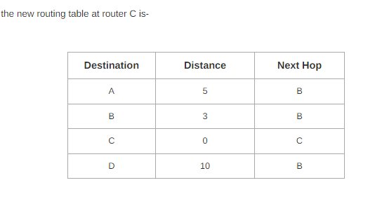

Slide 19
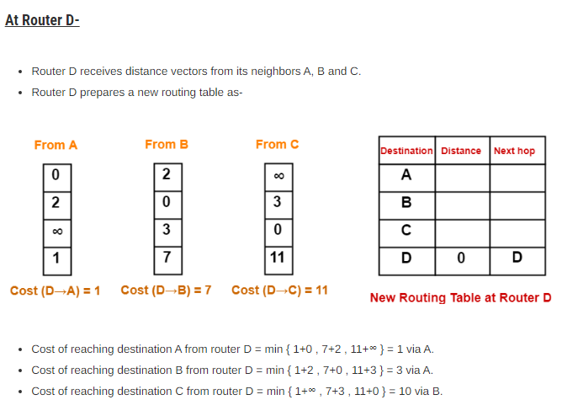

Slide 20
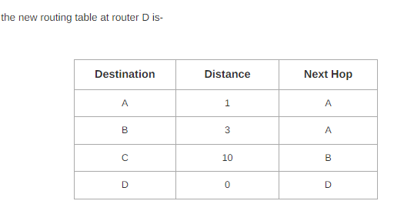

Slide 21
Step-03:
Each router exchanges its distance vector obtained in Step-02 with its neighboring routers.
After exchanging the distance vectors, each router prepares a new routing table.

Slide 22
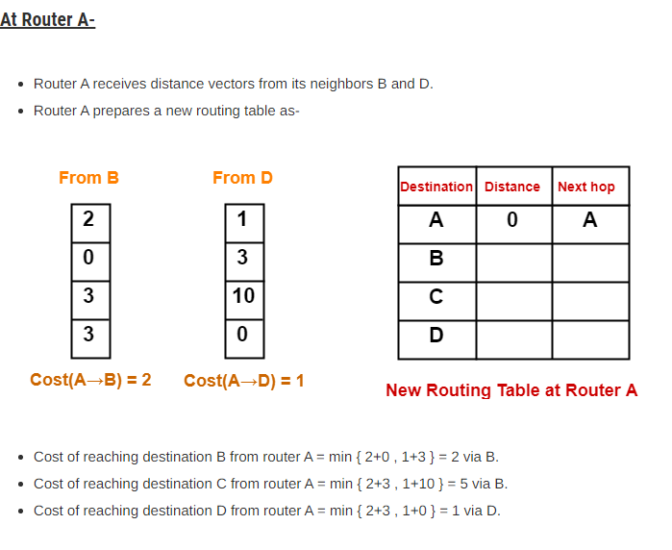

Slide 23
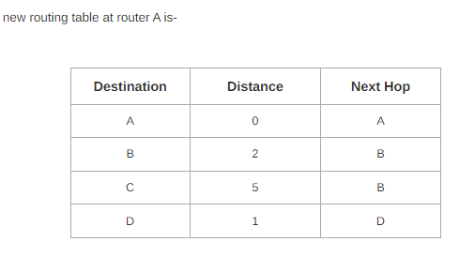

Slide 24
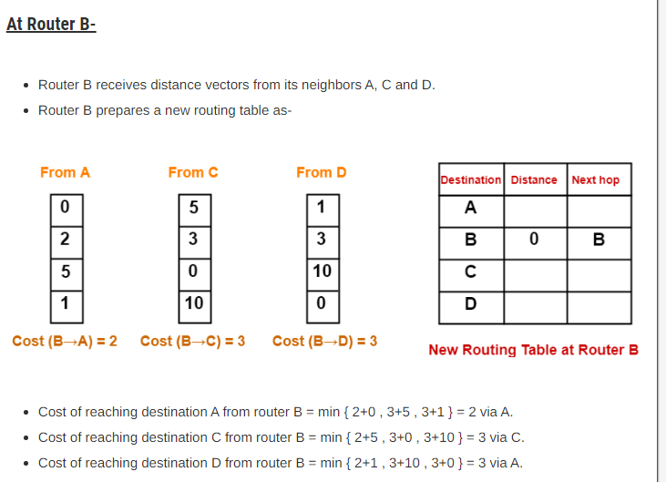

Slide 25
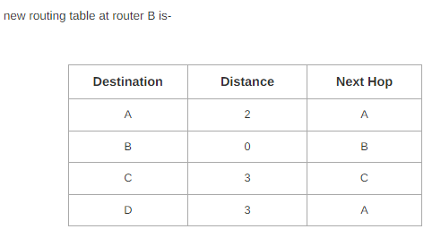

Slide 26
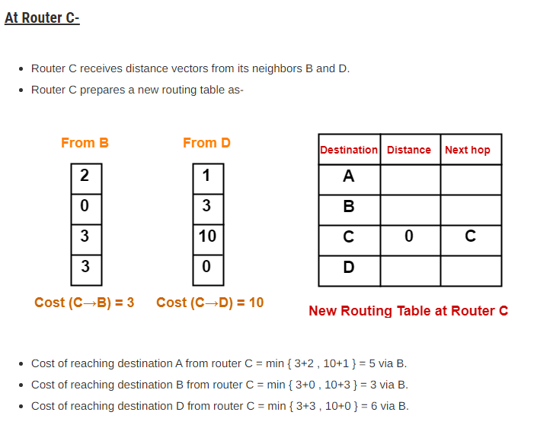

Slide 27
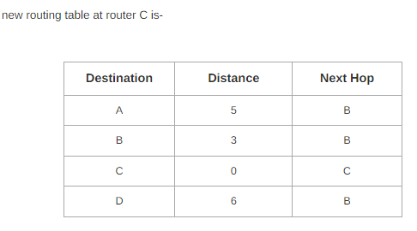

Slide 28
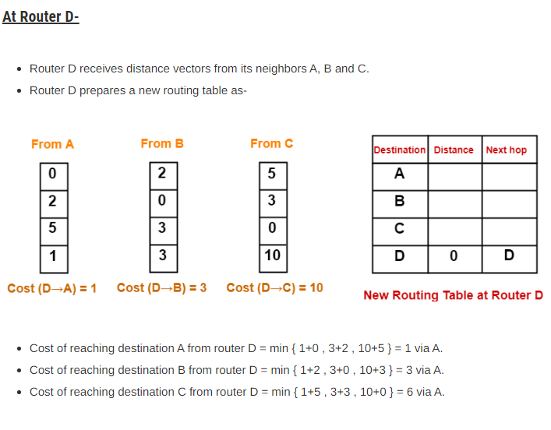

Slide 29
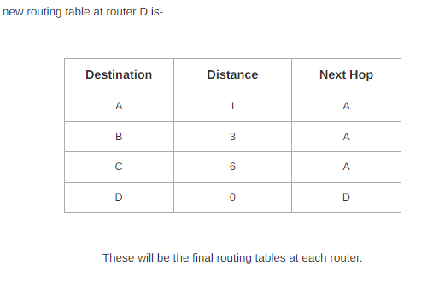

Slide 30
Important Notes-
In Distance Vector Routing,
Only distance vectors are exchanged.
“Next hop”values are not exchanged.
While preparing a new routing table-
A router takes into consideration only the distance vectors it has obtained from its neighboring routers.
It does not take into consideration its old routing table.
The algorithm is called so because-
It involves exchanging of distance vectors between the routers.
Distance vector is nothing but an array of distance
Routing tables are prepared total (n-1) times if there are n routers in the given network.
This is because shortest path between any 2 nodes contains at most n-1 edges if there are n nodes in the graph.
Distance Vector Routing suffers from count to infinity problem.

Slide 31
For more details:
https://www.gatevidyalay.com/distance-vector-routing-routing-algorithms/

Slide 32
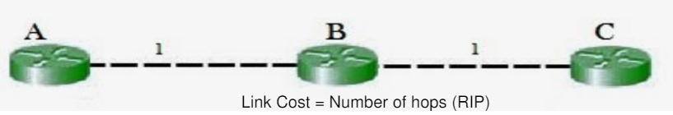
Count to infinity problem
The main issue with Distance Vector Routing (DVR) protocols is Routing Loops which causes Count to Infinity Problem.
Routing loops usually occur when any interface goes down or two-
routers send updates at the same time
Consider the diagram shown below

Slide 33
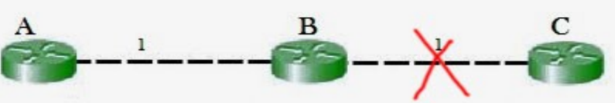
Count to infinity problem
In the figure ,B will know that it can get to C at a cost of 1, and A will know that it can get to C via B at a cost of 2
If the link between B and C is disconnected, then B will know that it
can no longer get to C via that link and will update the distance as infinity.
Before it can send any updates it’s possible that it will receive an
update from A which will be advertising that it can get to C at a cost
of 2.

Slide 34
Count to infinity problem
B can get to A at a cost of 1, so it will update a route to C via A at a
cost of 3.
A will then receive updates from B later and update its cost to 4.
They will then go on feeding each other bad information toward
infinity which is called as Count to Infinity problem
Solution for Count to Infinity problem:
Route Poisoning:
Split horizon

Slide 35
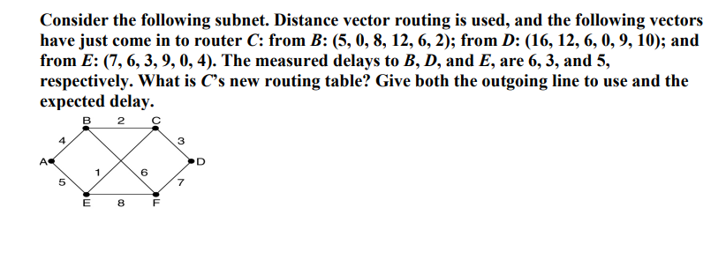

Slide 36
ANS: Going via B gives (11, 6, 14, 18, 12, 8).
Going via D gives (19, 15, 9, 3, 9, 10).
Going via E gives (12, 11, 8, 14, 5, 9).
Taking the minimum for each destination except C gives (11, 6, 0, 3, 5, 8).
The outgoing lines are (B, B, -, D, E, B).

Slide 37
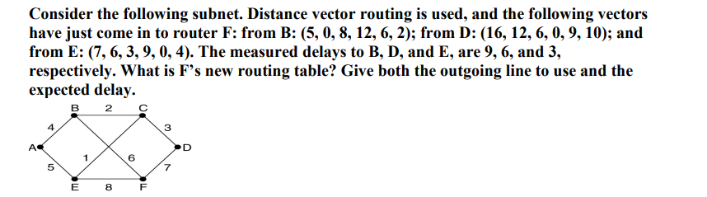

Slide 38
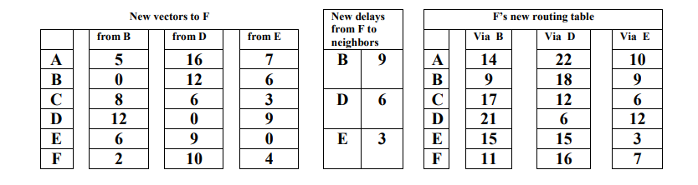
Going via B gives (14, 9, 17, 21, 15, 11) Going via D gives (22, 18, 12, 6, 15, 16) Going via E gives (10, 9, 6, 12, 3, 7) Taking the minimum for each destination except F gives (10, 9, 6, 6, 3, -) The outgoing lines are (E, B, E, D, E, -)

